Slide 1
Battery Management System based on Cloud Computing
Mohamed Elsyed

Slide 2
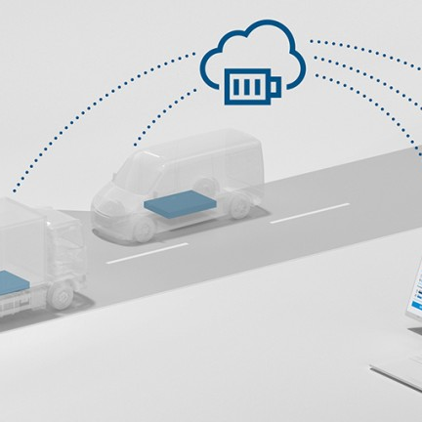
Agenda
Achieved work.
Next task.

Slide 3
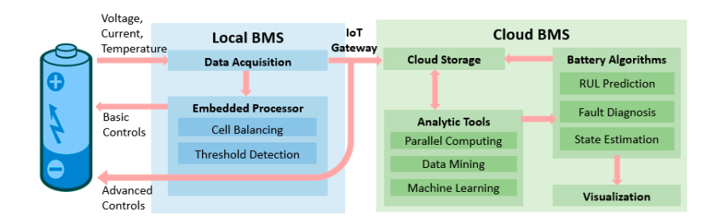
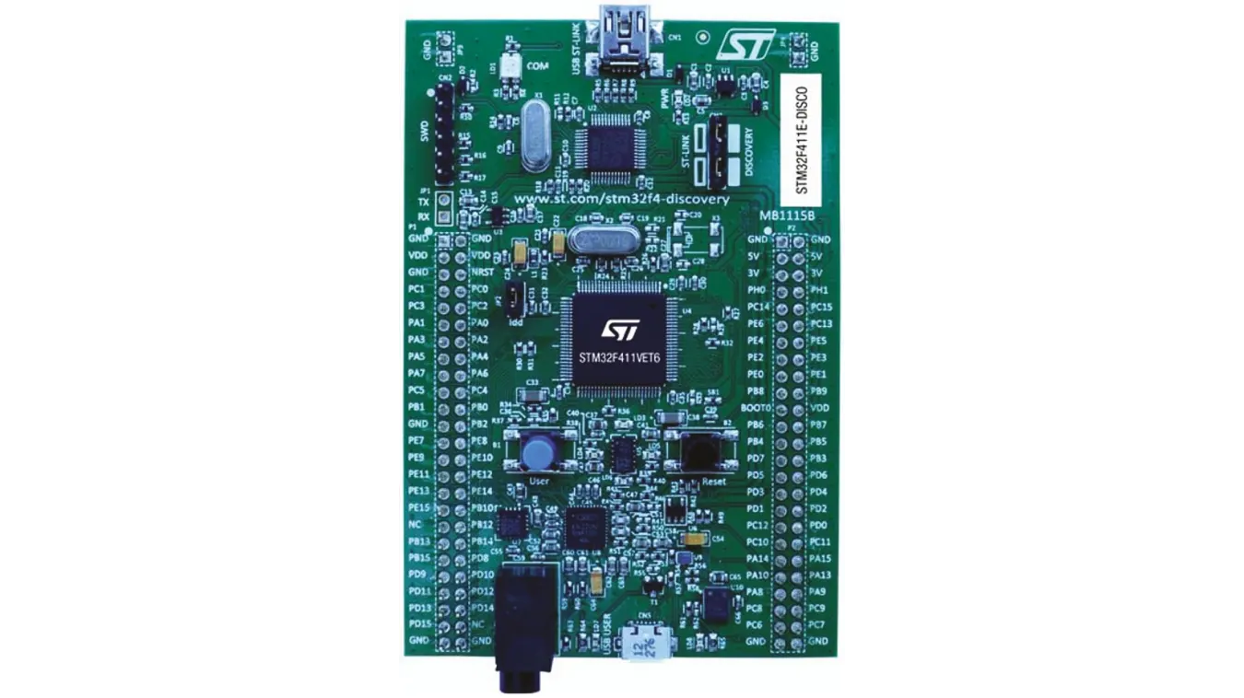
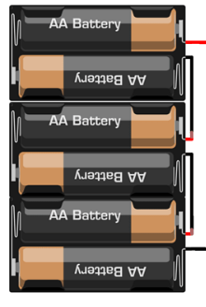
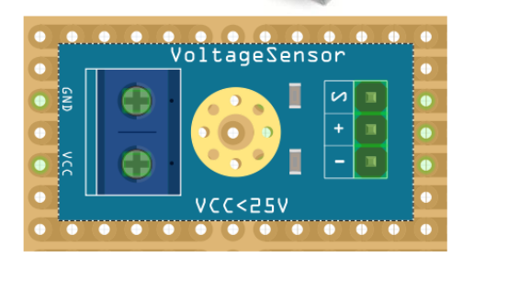
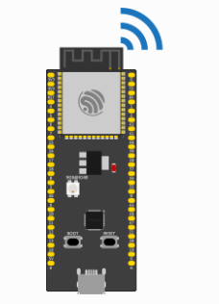


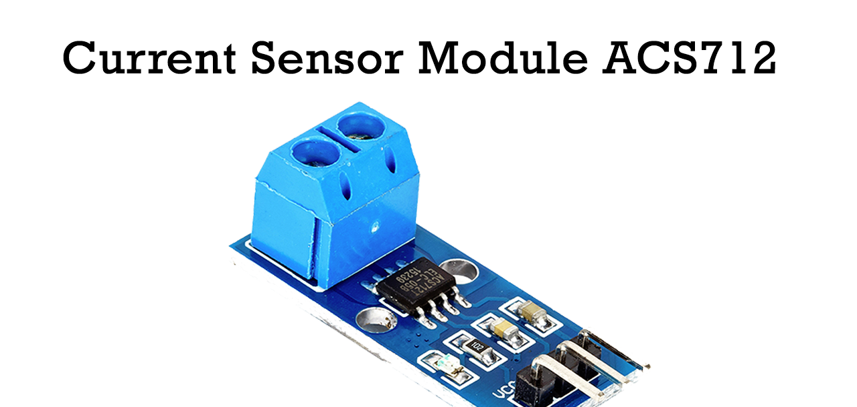

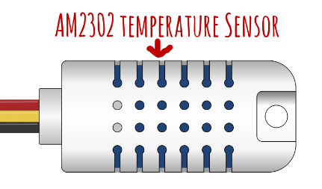
Could battery management
communication protocol

Slide 4
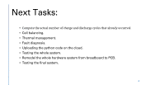

Timeline
Sensors Readings
Getting temperature, voltage, and current sensors readings using STM32-microcontroller.
Transmitting the read values to ESP32
Transmit the sensor reading values from STM32 to ESP32 using UART protocol.
Cloud python code
Create the cloud code using PAHO library.
Connect, subscribe, and get messages
- Connect to the broker.
- subscribe to the required topics.
- Receiving sensor measurements.
SOC Estimation
SOH Estimation
- Compute the SOH of self-discharge.
- Compute the SOH of number of cycles.
Cycle Life Prediction
- estimate the total life cycles: number of charge and discharge
Cycles that battery may live , according to the battery behavior.
Next:………

Slide 5
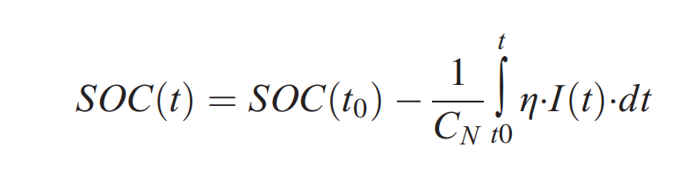
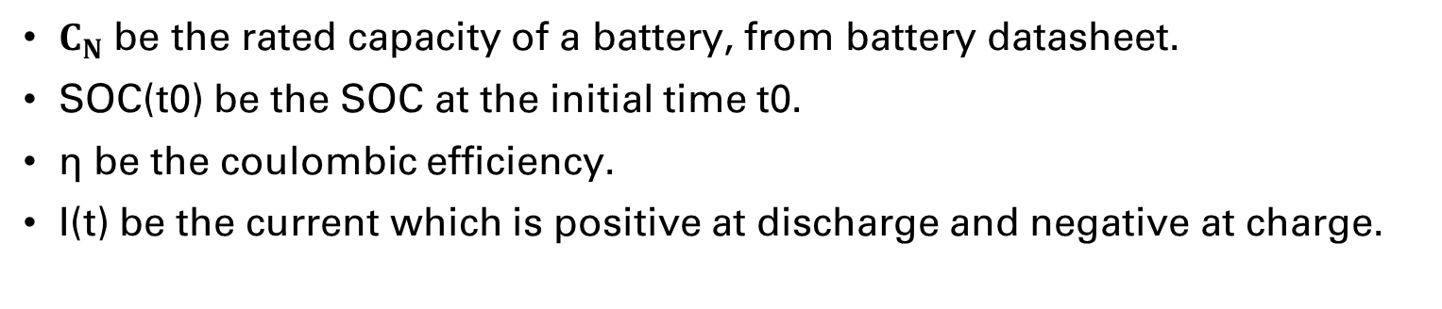
State of Charge Estimation:
$C_{N}$ be the rated capacity of a battery, from battery datasheet.
SOC(t0) be the SOC at the initial time t0.
η be the coulombic efficiency.
I(t) be the current which is positive at discharge and negative at charge.

Slide 6
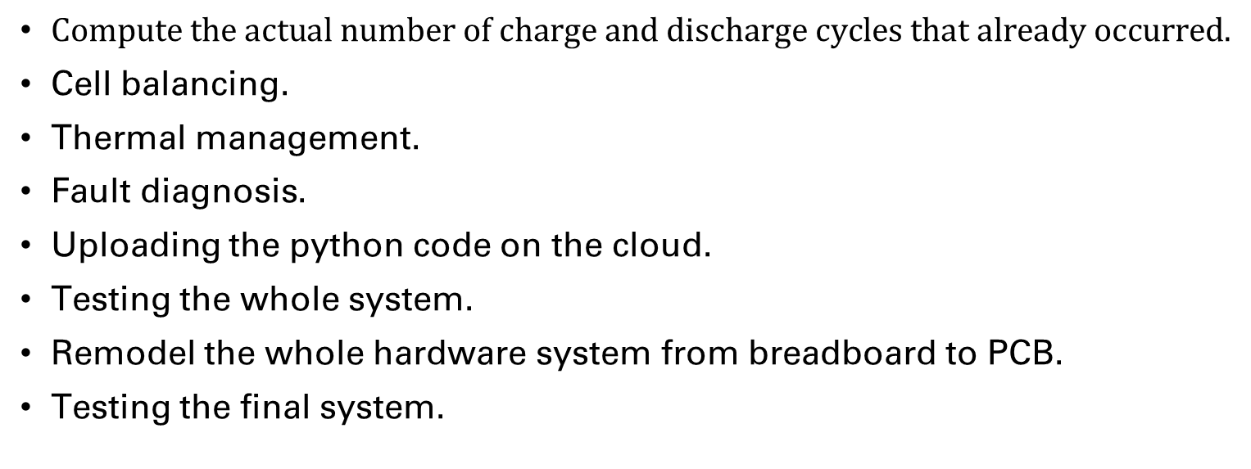
Next Tasks:
$Compute the actual number of charge and discharge cycles that already occurred.$
Cell balancing.
Thermal management.
Fault diagnosis.
Uploading the python code on the cloud.
Testing the whole system.
Remodel the whole hardware system from breadboard to PCB.
Testing the final system.

Slide 7




Thank you

